Slide 1


AMP Credit Technologies
Giving Credit Its Due.
Lending Automation For Banks
18 May 2017
Hong Kong | United Kingdom | Singapore

Slide 2




A leader in innovative small business lending solutions
AMP Credit Technologies
Founded in 2009, AMP Credit Technologies is a financial technology company focused on highly automated lending solutions for banks and other financial institutions offering all forms of credit to small businesses.
Operating across Asia-Pacific and the EMEA region, the
firm has received numerous awards – including Retail Banker International’s “Asia Trailblazer” and European FinTech’s “Top 100”.
AMP is a founding member and sits on the Advisory Board of the G20’s SME Finance Forum, operated by the International Finance Corporation (IFC).
* Increase profit
* Improve efficiency
* Expand products
* Reduce risk
* Lower costs

Slide 3
The problem
Banks recognize small business lending as one of the few available areas for revenue growth, but face a number of seemingly conflicting goals in tapping it:
Increase lending to small businesses
But don’t charge too much
Increase revenues
But don’t increase costs
Do not lose money
Or increase regulatory risk
Offer modern technology services
But locked into legacy IT
Banks are seeking to improve the efficiency of loan origination operations, whilst approving loans quicker, based upon robust credit analysis of new and existing data sources.

Slide 4
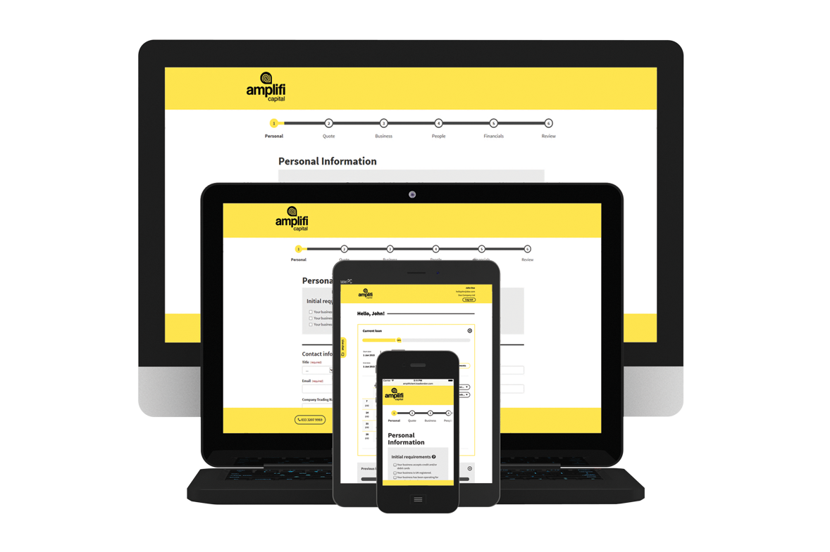
AMP’s solution - CAIROSTM
Empowering banks and other institutions for small business lending
CAIROSTM, AMP’s scalable technology platform implemented on a discrete “white-label” basis, enables lenders to improve the profitability, increase operating efficiencies, and expand the scope of their small business lending strategies.

Slide 5
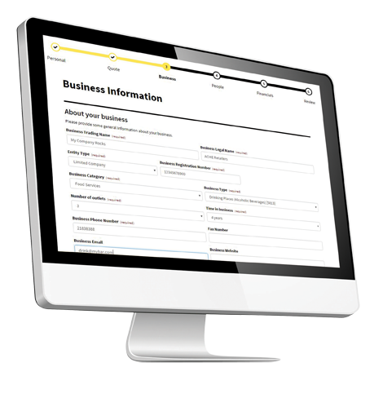
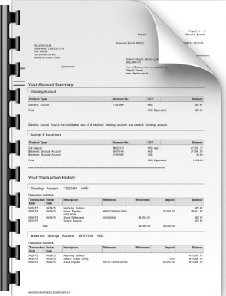
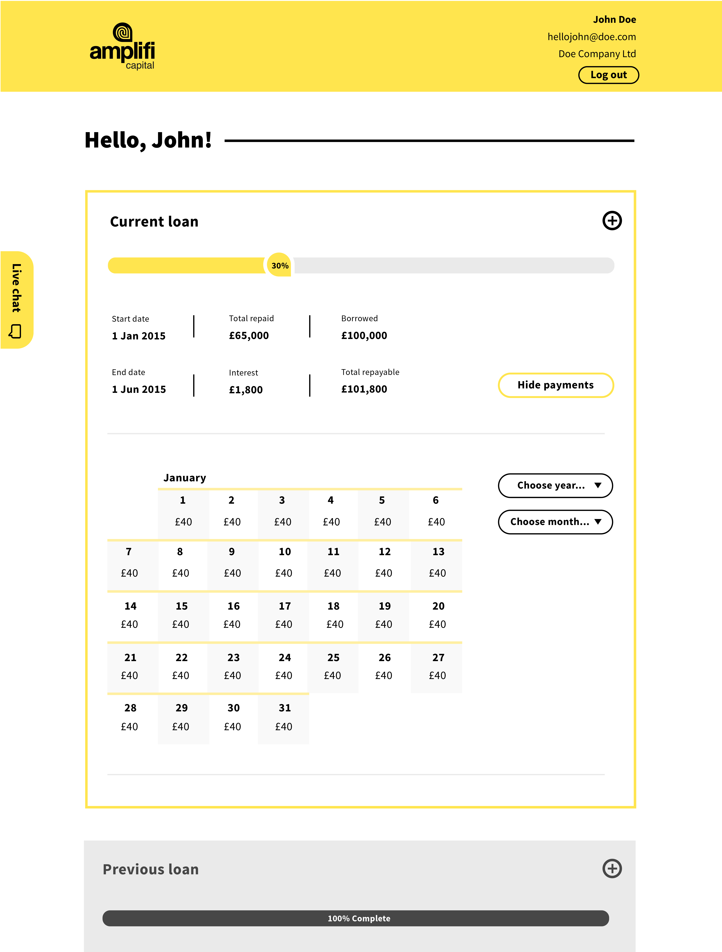


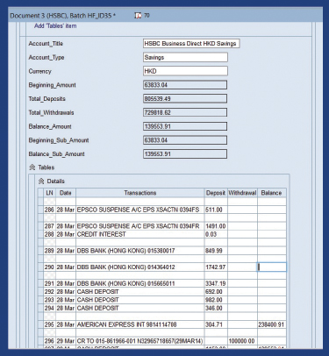
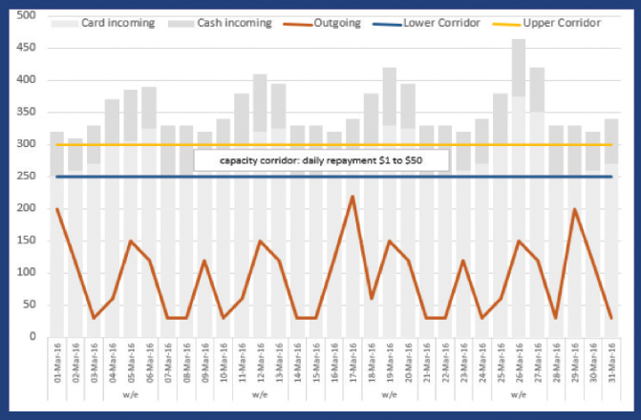
Features and functionality
A straight-through solution for small business credit applications
CAIROSTM automates the entire credit application workflow, capturing data from the most efficient source, and presenting assessments in any format required by the lender.
Omni-channel customer onboarding
Information capture from any source
SME credit assessment
Loan documentation
Portfolio servicing
Risk management tools
E signature
Providing loan assessments in the “scorecard” format desired by banks ensures interoperability with existing procedures and expedites user adoption.

Slide 6
5
Example Problems Solved by AMP
Speeding Loan Decisions and Reducing Costs through Automation
Enabling the Online Customer Journey for Legacy Banks
Managing the Loan Origination Process for Efficiency and Compliance
Reducing Errors and Delays with Automated Loan Document Creation
Specialist Credit Models to enable lending to SMEs in thin file markets
Loan Systems of Record (where the core banking system is inadequate)

Slide 7

AMP Commitment to CEE Region
We are experienced and resourced for CEE projects
UK platform for CEE delivery
CEE clients in Austria and Croatia
Development center in Bulgaria
Actively seeking CEE opportunities

Slide 8
Speak to us:
How can we help improve your
small business lending?
Thomas J. DeLuca
Chief Executive Officer
thomas.deluca@amp-creditech.com
AMP Credit Technologies United Kingdom
Level 39, One Canada Square, 24F
Canary Wharf
London E14 5AB

