Slide 1
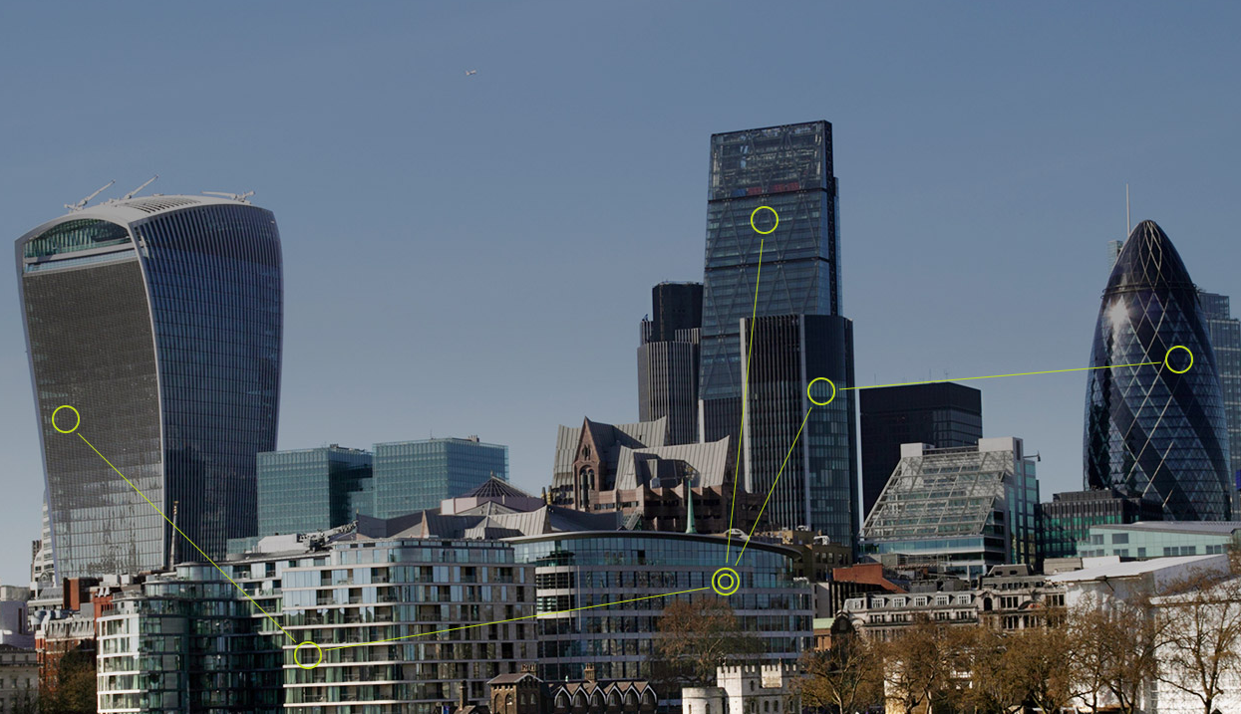
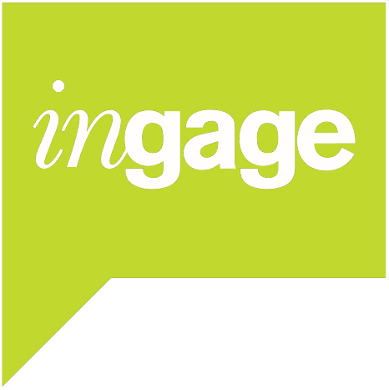
A new way of bringing investors & listed companies together
London
Tokyo
Chicago
Amsterdam
Munich
Edinburgh

Slide 2
A private marketplace to connect corporates and institutions
corporate
IR software CRM system designed for mobility: iPhone iPad & offline
Organisation of bespoke trips, meetings and calls across the world
Integrate Shareholder ID / SRA from any provider, meeting notes & records, contacts & profiles, detailed reporting
MiFID II compliant record keeping & reporting on all your corporate access activity. Direct feedback on any meeting
ingage
Direct connection between corporate & institution: Automated, confidential feedback; advertise roadshows; accurate, user maintained profiles
Full service electronic meeting marketplace: negotiate slots in real time, backed up by in house logistics
institution

Slide 3
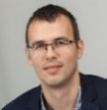
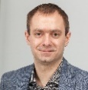
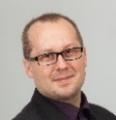
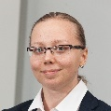
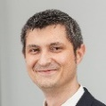
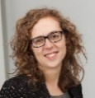
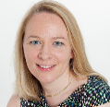
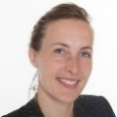
Experienced team from across the industry
Michael Hufton
Founder & Managing Director
22 years experience including buy & sell-side roles at Cazenove & Co, SR, Polar Capital
Simon Mohamed
Director of Engineering
22 years software engineering experience at Microsoft, Yahoo, Macrovision, Avaya and Novell.
Łukasz Drzewiecki
Lead Software Engineer
13 years experience in software development at Microsoft, BRE and Intive
Roel Jacobs
Sales & Account Management
25 years experience in equity sales and IR solutions.
Krzysztof Wystemp
Senior Software Engineer
10 years experience in software development at Santander, Synity and Intive
Michal Kraus
Lead Test Engineer
5 years experience in Testing and Quality Assurance at Atos, Gigaset, PGS and Intive
Jon Fox
Sales & Account Management
9 years financial software implementation and investor relations sales.
Tomasz Przybylski
Senior Software Engineer
15 years software development experience at Microsoft, Credit Suisse and Intive
Cecylia Nowakowska
Test Engineer
4 years experience in Testing and Quality Assurance at Gigaset and Intive
Caroline Kearins
Operations & Logistics
9 years front of house, administrative support and corporate events experience.
Paweł Gleń
Senior iOS Software Engineer
6 years experience developing iOS software
Marta Krzyżelewska
Test Engineer
4 years software testing experience at Atos and Objectivity
Charlye Lagriffoul
Operations & Logistics
4 years experience in customer relations,
administrative and event experience.
Kristina Farrell
Technical Author
19 years experience: FMCG; Retail Marketing;
E-commerce; Technical Authoring and User Training
James Badcock
CFO
25 years accounting & finance experience,
Chartered Accountant
Rozzi Walton
Sales & Account Management
13 years experience in financial services.
We need more good people !
If you’d like to join us, please make contact
3

Slide 4
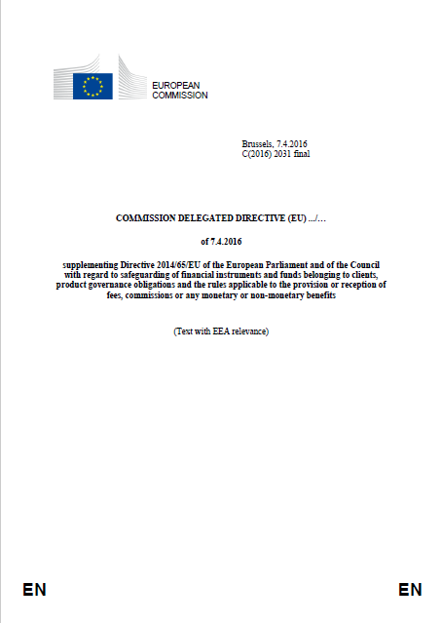
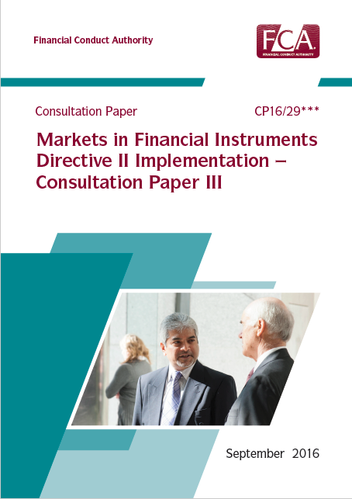
Regulation an important catalyst for change MiFID II the most significant reform since Big Bang
FCA proposals published – CP16/29
Expect final FCA Policy Statement June 2017
In rulebook by 3rd July 2017 - Transposition Deadline
6 months to implement - In Force Date 3rd Jan 2018
Local rules, applies in the UK irrespective of Brexit
Hard unbundling. Execution, Research & Corporate Access must be separately priced, no cross-subsidy allowed
Corporate Access is an inducement and is not research
Minor non monetary benefit exemption extremely limited
Detailed record keeping & reporting requirement
Radical change to the existing model – direct will grow and new solutions are needed
4

Slide 5
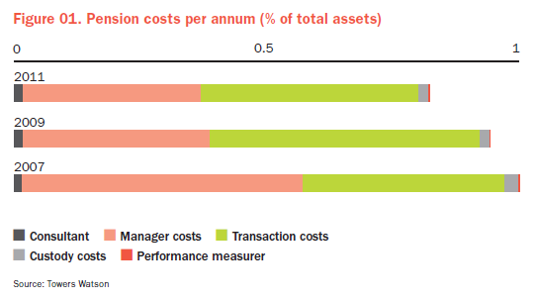
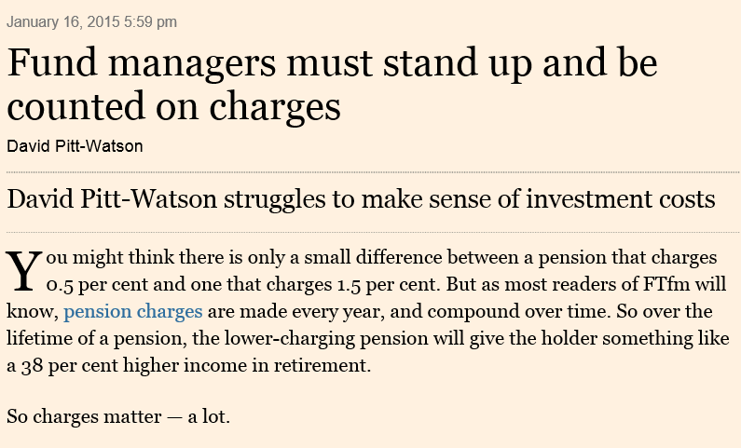
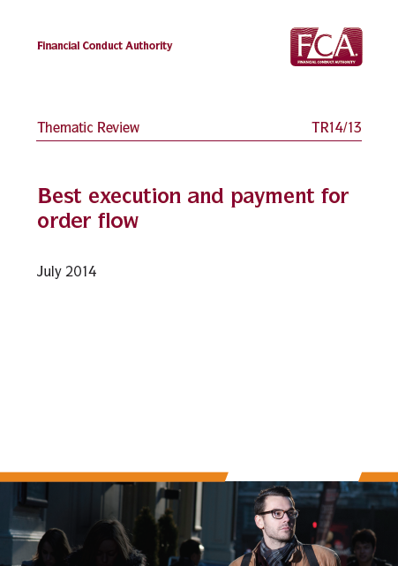
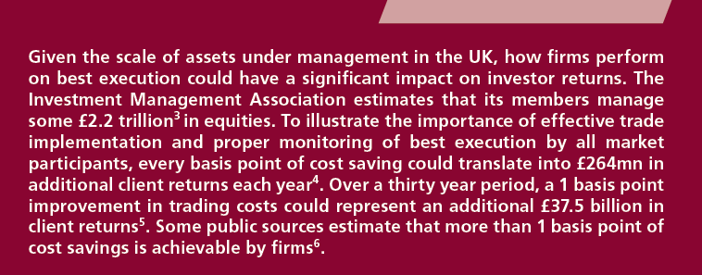
A huge opportunity for asset managers. The problem isn’t with management fees, it’s the pass-through of transaction costs
5

Slide 6
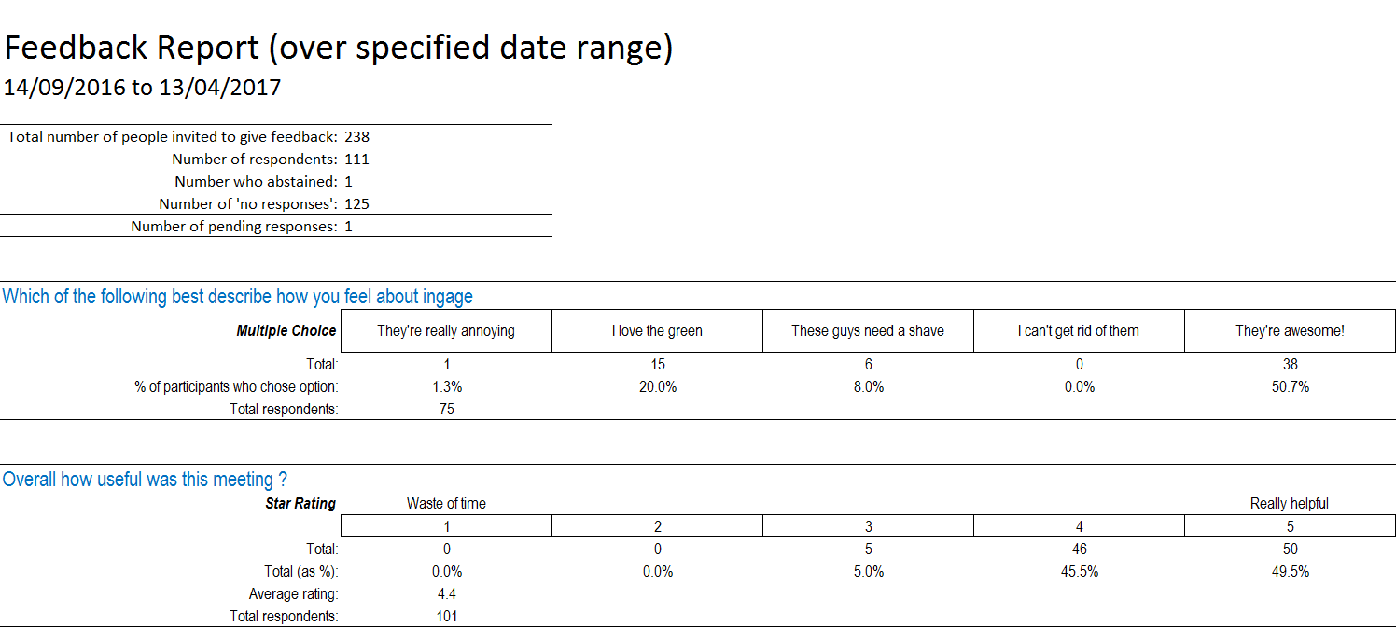
Corporate & institutional Investor Feedback
Collecting & analysing feedback via the ingage platform on all our corporate and institutional meetings
111 corporate & 77 institutional respondents, 7 months, Sept 2016 – Apr 2017
80% of institutions expect more meetings to be arranged directly
half expect to use marketplace software - but 77% don’t yet have a platform
56% of corporates think the traditional feedback system doesn’t work well
A third say their IR CRM platform isn’t intuitive & cite poor mobile performance
institutional motivations: regulatory push, efficiency, best practice, take control
corporate motivations: direct feedback, modern architecture, mobility, analytics
6

Slide 7
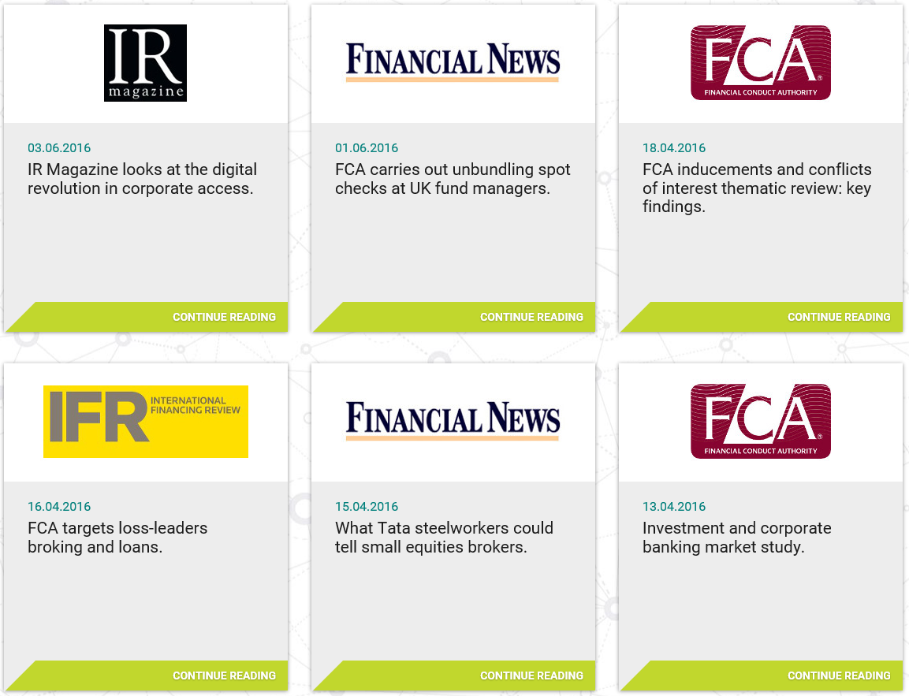
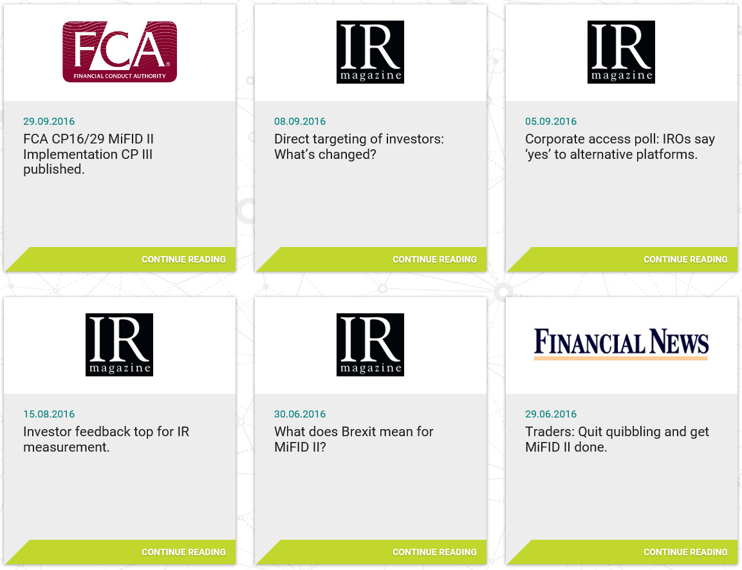
Thought leadership to develop brand recognition & adoption
Increasing awareness among IROs and asset managers. Global press coverage & use of LinkedIn
Presentations for IR organisations at conferences around the world
7

Slide 8
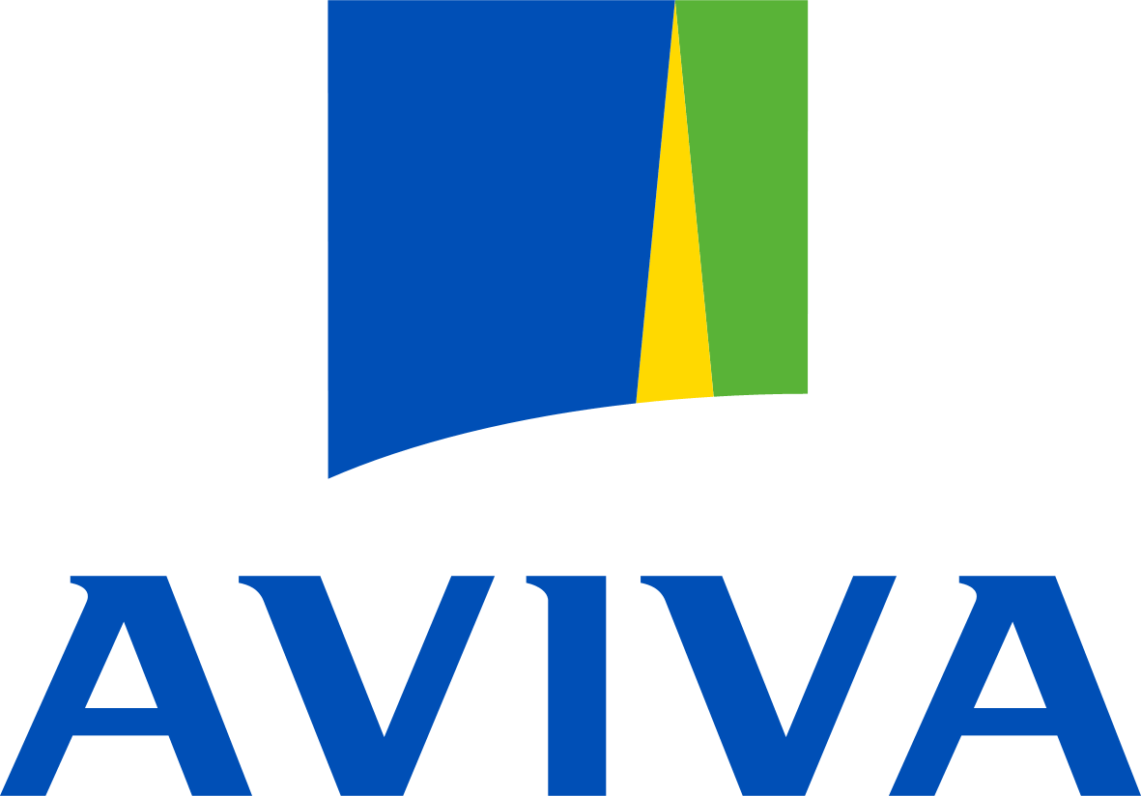
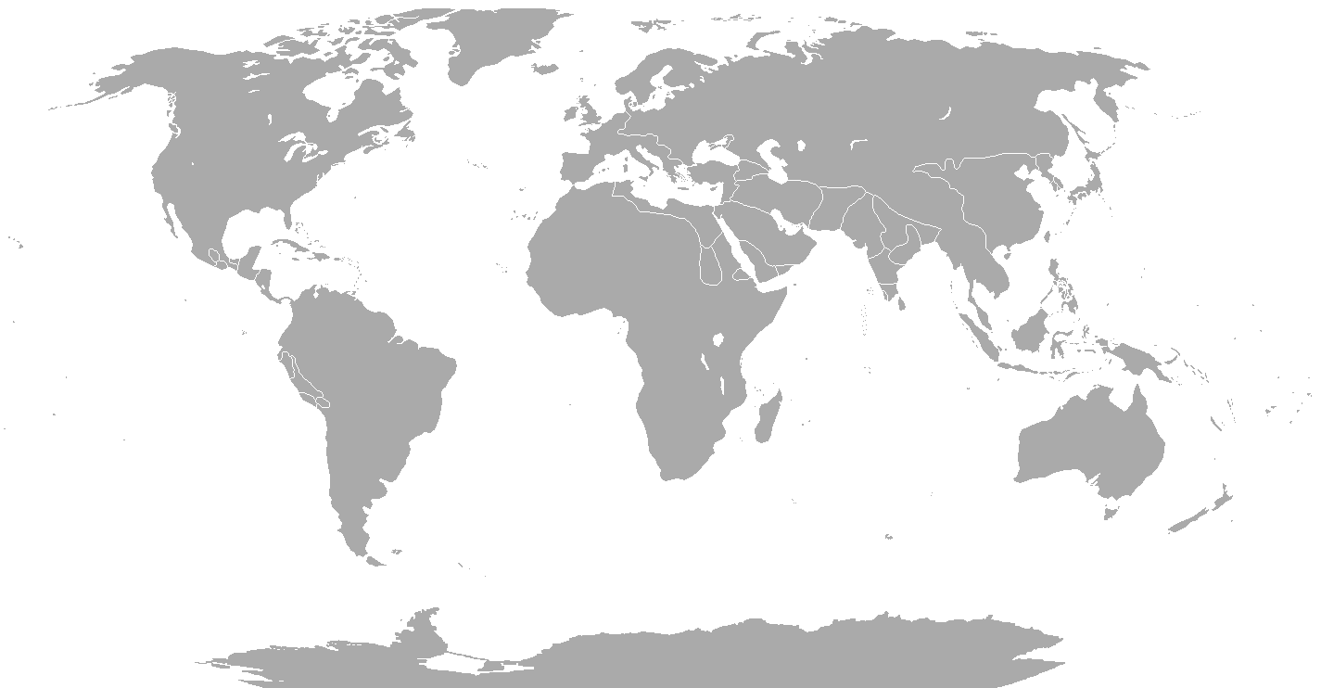
Corporates we’ve arranged meetings with for our institutional clients
8

Slide 9
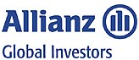
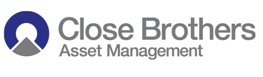
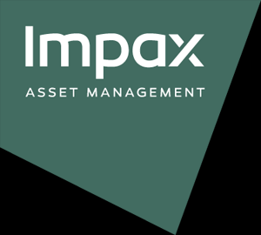
Institutions we’ve arranged meetings with for our corporate clients
9

Slide 10
What our corporate clients say about us
“Tullow has been working with ingage for a number of years to ensure we stay abreast of the changing regulatory landscape. The ingage team have always provided a first class service and we have done a number of excellent Management roadshows with them in London and Edinburgh. Getting direct feedback from investors is extremely helpful when analysing the success of a roadshow and the ingage platform delivers that service in a timely and transparent manner.”
“ingage organised two excellent roadshows for us. The logistics were spot on, even when we had to move meetings around during the roadshow. The team quickly and efficiently shuffled meetings to accommodate us. The feedback process was invaluable - the team helped us devise questions that gave us valuable insights into investor perceptions and their intention to invest."
“A customer focused team, intuitive/easy to use app. ingage is a powerful ingredient to help drive our IR team forward.”
“User friendly, great access team, flawless execution, impressive customer orientation. We like it.”
“You’ve revolutionised Scotland for us.”
“As a pan-European exchange operator we are keen to be at the cutting edge of best practice and follow new developments closely. ingage offers a unique platform and brings new tools to our IR which we are keen to put into practise.”
10

Slide 11
What our institutional clients say about us
“ingage has impressed us with their innovative solution to corporate access. It is increasingly clear that financial institutions need to find a new way to arrange access with corporates and ingage provides that with a transparent, unconflicted and efficient solution. Moving forward, we would like to encourage the companies in which we invest to start offering roadshow meetings to us via ingage.”
“There is a substantial risk that any feedback that we give to companies via their broker or adviser is filtered and even diluted. We are therefore reluctant to channel feedback via this route. However, ingage offers us a simple, unconflicted way of passing feedback to the companies we meet, whether attributed or not. Moreover, they are able to feed back their thoughts on us as investors and how well we were prepared for the meeting, which helps us improve the way we interact with the companies we meet.”
“I think the reason we were keen to go with ingage and to help it get some traction is because we like that its model is completely unconflicted. It’s very clear that its service is there to administer meetings between companies and investors – that’s all. And it does that very well.”
“[With the broker model] there’s obviously a lot more room for conflict, and one concern we have is that this model gives brokers the ability to charge for those services, even though it’s not always clear what they’re doing to earn their fee.”
“Process improvement and cost efficiency are at the heart of what we do, so as to maximise returns to the pensioners whose assets we manage. As a result we increasingly deal directly with the corporate issuers we invest in - and MiFID II will accelerate this trend. The ingage platform provides us a state-of-the-art tool which allows us to manage our interaction with corporates efficiently and effectively. We will be implementing ingage across our long-term equity investment team and we would encourage the corporate issuers we invest in to offer us roadshow meetings via ingage.”
“As the number of corporate adopters grows, ingage will become an increasingly valuable resource for investors, eliminating conflict by providing a direct link to corporate issuers.”
11

Slide 12
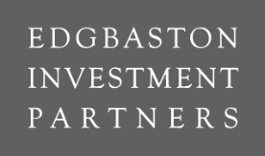
Retained clients We act for some of the world’s most influential corporates and investors
12

